Slide 1
Personal project
Basketball Team Management
Presented by
Anh Tú --- Non-IT class

Slide 2
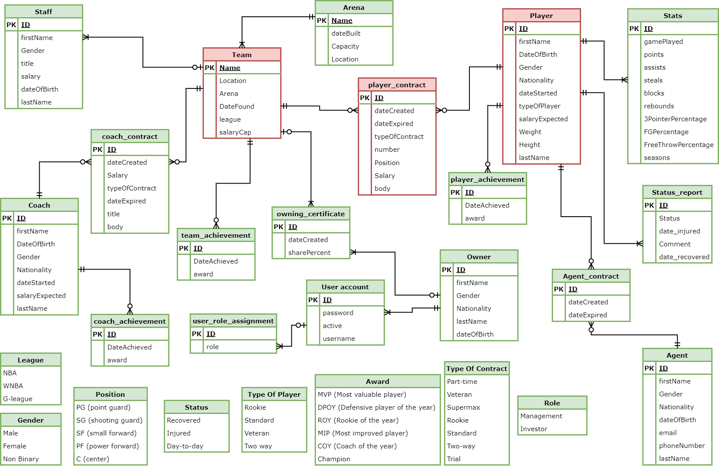
Entity Relationship Diagram

Slide 3
The purpose of this application
There are two kind of people who are using this application
1. Owner/Management team :
Help them control all the information about the teams they own (like view, update, delete or add new information)
2. Investors:
View all the information necessary to help them understand better about their investment (like team, player information)

Slide 4
Features
Basic find all, create, update, delete function for all 16 entities
Find agent, coach, player, staff, owner by first name, last name or ID
Find players currently in a team
Find team by name
Find player contract by player ID, team name or year
Find team achievement by team name
Find player contracts that are created or expired in a specific year
Find stats of a specific player
Find status report of a specific player
Update, create new player contract
Calculate total salary the owner must pay for a team
.....

Slide 5
Demonstration
Imagine that you are an owner using this application and now is the end of the season
Sign in to your account and get authorization
Check all the teams you own
View all the players currently on the team
Check their contracts status
Player with contract that about to expire
Let the contract expire
Update the contract with that player

Slide 6
Demonstration
What is this player expected salary ?
Update the contract with this player
Try to negotiate with this player to lower the salary
Terminate other player contract to make space

Slide 7
End of the presentation
QUESTION ???

Slide 8
GOODBYE
THANK YOU FOR LISTENING !!!!

